Slide 1
Machine learning problems
Mohammad ghoddosi

Slide 2
Machine learning main challenges
Insufficient Quantity of Training Data
Nonrepresentative data
Poor-quality data
Irrelevant feature
Overfitting
Underfitting

Slide 3
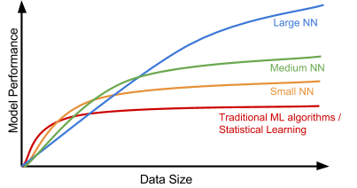
Data size

Slide 4
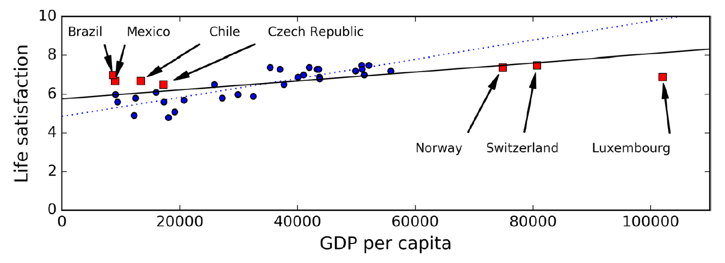
Nonrepresentative data

Slide 5
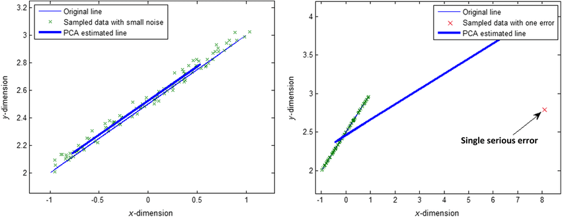
Poor-quality data

Slide 6
Handling data quality
Noise
Outlier
Missing value

Slide 7
Missing values
Get rid of the row
df.dropna()
Get rid of the attribute
df.drop(attribute)
Set missing values to some value
sklearn.preprocessing.Imputer()

Slide 8
Set missing values to some value
Out of range value (label as missing)
Mean
Median
Machine learning models

Slide 9
Irrelevant feature
Garbage in, garbage out
Feature selection
Feature extraction
Gathering new features

Slide 10
Online / offline learning
We don’t have all data
We need model to update during test time
Good for dynamic environments

Slide 11
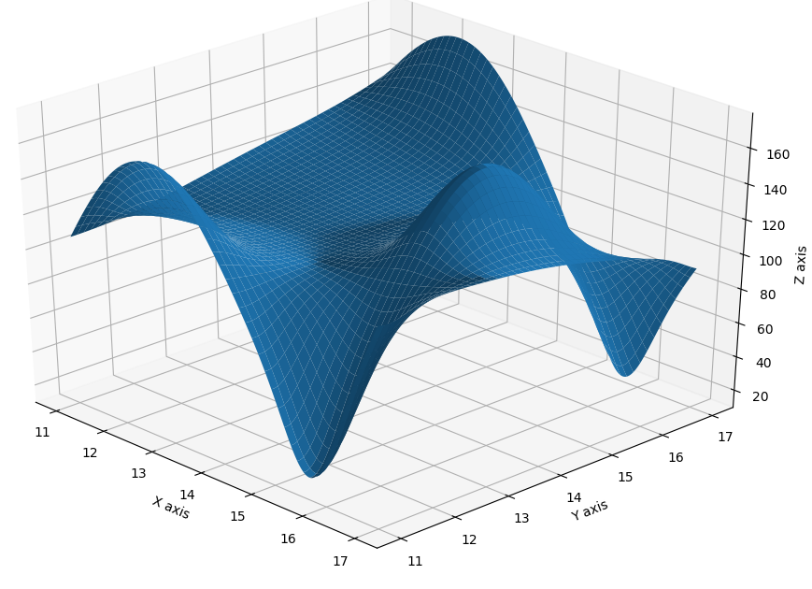
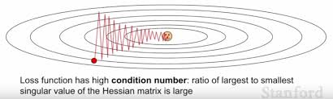
Problems in optimizers
Plateau
Saddle point
Local minimum
Zig-zag moves

Slide 12
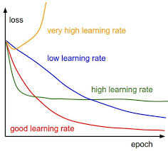
Gradient decent - LR

Slide 13
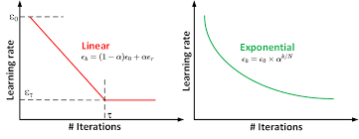
Gradient decent – decay LR

Slide 14
stochastic gradient descent (SGD)
Stochastic moves
avoiding local minimum
avoiding saddle points
avoiding plateau
Computational complexity

Slide 15
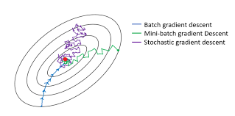
Mini-batch gradient descent
Mini-batch
Not too stochastic
Fast
Scalable
Batch size
epoch

Slide 16
Momentum
Like momentum in physics
Remember update at each step
Determine next update using
Gradient
Pervious updates
avoiding zig-zag moves

Slide 17


Momentum formula
Normal GD:
Momentum GD:
$$ΔW=−η∇J$$
$$v=αv −η∇J$$
$$ΔW=v$$

Slide 18
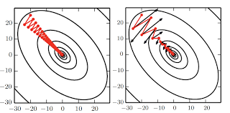
Momentum effect

Slide 19
Adaptive learning rate
Increase or decrees learning rate during training
different learning rates for different parametters
AdaDelta
AdaGrad
RMSprop
Adam

Slide 20


AdaGrad
scaling learning rates inversely proportional to the square root of the sum of all the historical squared values of the gradient
For $w_{i}$ where $\frac{∂J}{∂w_{i}}$ is small, ${Δη}_{i}$ is small
For $w_{j}$ where $\frac{∂J}{∂w_{j}}$ is large, ${Δη}_{j}$ is large
Not good in some nonconvex functions
$$r=r+\left(∇J ⨀ ∇J\right)$$
$$ΔW=−\frac{η}{δ+\sqrt{r}}∇J$$

Slide 21

RMSprop
Better than AdaGrad in nonconvex functions
Like AdaGrad but with leakage
$$r=ρr+(1−ρ)\left(∇J ⨀ ∇J\right)$$
$$ΔW=−\frac{η}{δ+\sqrt{r}}∇J$$

Slide 22

Adam
Using both momentum and RMSprop
$$r=ρr+(1−ρ)\left(∇J ⨀ ∇J\right)$$
$$v=αv−\frac{η}{δ+\sqrt{r}}∇J$$
$$ΔW=v$$

Slide 23
visualization
https://emiliendupont.github.io/2018/01/24/optimization-visualization/

Slide 24
Evolutionary computing
Another optimization methods
Based on generation
Natural selection
Survival of the fittest

